Slide 1

Large-Scale Machine Learning: k-NN, Perceptron
Note to other teachers and users of these slides: We would be delighted if you found this our material useful in giving your own lectures. Feel free to use these slides verbatim, or to modify them to fit your own needs. If you make use of a significant portion of these slides in your own lecture, please include this message, or a link to our web site: http://www.mmds.org
Mining of Massive Datasets
Jure Leskovec, Anand Rajaraman, Jeff Ullman Stanford University
http://www.mmds.org

Slide 2
New Topic: Machine Learning!
High dim. data
Locality sensitive hashing
Clustering
Graph data
PageRank, SimRank
Community Detection
Infinite data
Filtering data streams
Web advertising
Dimensionality reduction
Spam Detection
Queries on streams
Machine learning
SVM
Decision Trees
Perceptron, kNN
Apps
Recommender systems
Association Rules
Duplicate document detection

Slide 3
Supervised Learning
Would like to do prediction:
estimate a function f(x) so that y = f(x)
Where y can be:
Real number: Regression
Categorical: Classification
Complex object:
Ranking of items, Parse tree, etc.
Data is labeled:
Have many pairs {(x, y)}
x … vector of binary, categorical, real valued features
y … class ({+1, -1}, or a real number)
X
Y
X’
Y’
Training and test set
Estimate y = f(x) on X,Y. Hope that the same f(x) also works on unseen X’, Y’

Slide 4
Large Scale Machine Learning
We will talk about the following methods:
k-Nearest Neighbor (Instance based learning)
Perceptron and Winnow algorithms
Support Vector Machines
Decision trees
Main question: How to efficiently train (build a model/find model parameters)?

Slide 5
Instance Based Learning
Instance based learning
Example: Nearest neighbor
Keep the whole training dataset: {(x, y)}
A query example (vector) q comes
Find closest example(s) x*
Predict y*
Works both for regression and classification
Collaborative filtering is an example of k-NN classifier
Find k most similar people to user x that have rated movie y
Predict rating y_{x} of x as an average of y_{k}

Slide 6
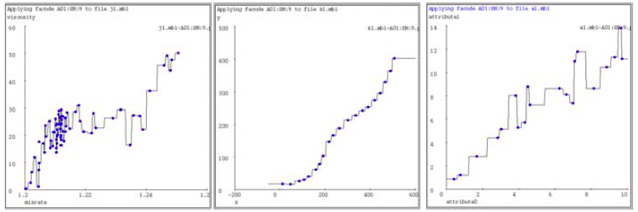
1-Nearest Neighbor
To make Nearest Neighbor work we need 4 things:
Distance metric:
Euclidean
How many neighbors to look at?
One
Weighting function (optional):
Unused
How to fit with the local points?
Just predict the same output as the nearest neighbor

Slide 7
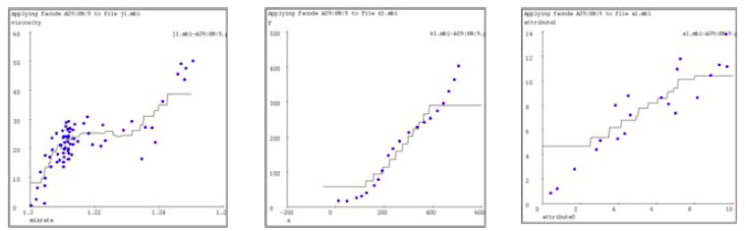
k-Nearest Neighbor
Distance metric:
Euclidean
How many neighbors to look at?
k
Weighting function (optional):
Unused
How to fit with the local points?
Just predict the average output among k nearest neighbors
k=9

Slide 8
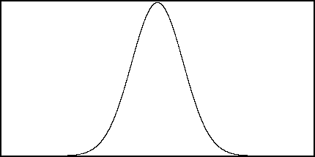
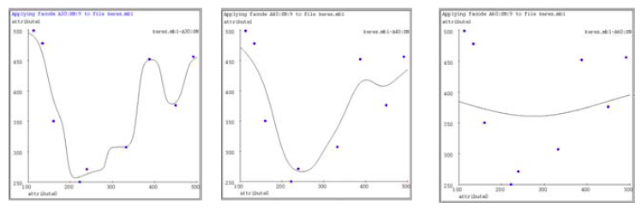
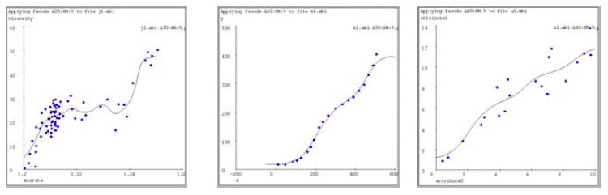
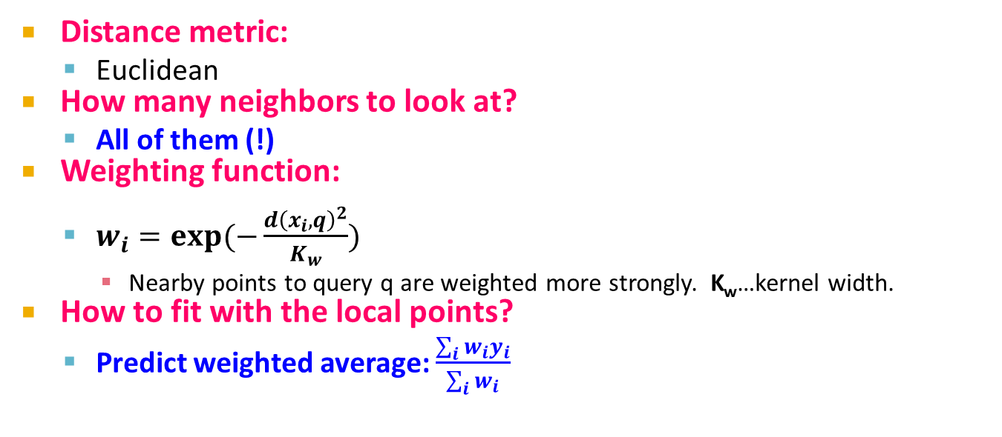
Kernel Regression
Distance metric:
Euclidean
How many neighbors to look at?
All of them (!)
Weighting function:
$w_{i}=exp⁡(−\frac{d{\left(x_{i},q\right)}^{2}}{K_{w}})$
Nearby points to query q are weighted more strongly. K_{w}…kernel width.
How to fit with the local points?
Predict weighted average: $\frac{\sum_{i}{w_{i}y_{i}}}{\sum_{i}{w_{i}}}$
w_{i}
d(x_{i}, q) = 0
K_{w}=10
K_{w}=20
K_{w}=80

Slide 9
How to find nearest neighbors?
Given: a set P of n points in R^{d}
Goal: Given a query point q
NN: Find the nearest neighbor p of q in P
Range search: Find one/all points in P within distance r from q
p
q

Slide 10
Algorithms for NN
Main memory:
Linear scan
Tree based:
Quadtree
kd-tree
Hashing:
Locality-Sensitive Hashing
Secondary storage:
R-trees

Slide 11
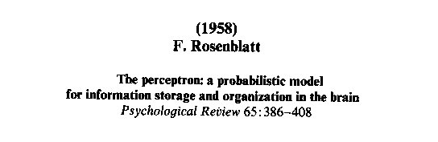
Perceptron

Slide 12
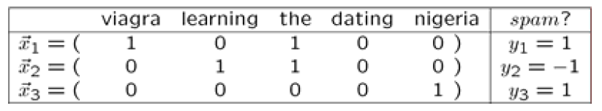
Linear models: Perceptron
Example: Spam filtering
Instance space x ∈ X (|X|= n data points)
Binary or real-valued feature vector x of word occurrences
d features (words + other things, d~100,000)
Class y ∈ Y
y: Spam (+1), Ham (-1)

Slide 13
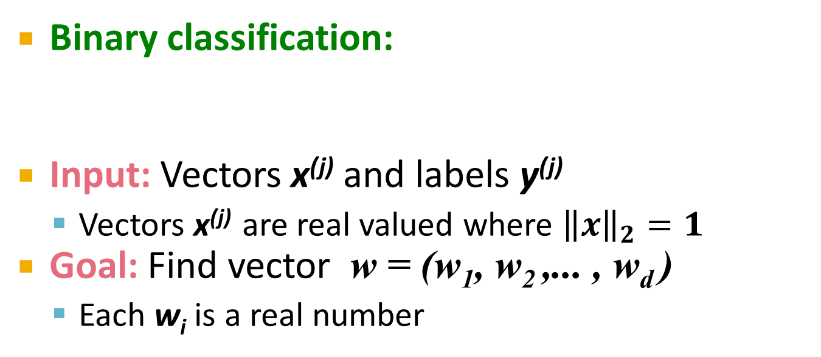
Linear models for classification
Binary classification:
Input: Vectors x^{(j)} and labels y^{(j)}
Vectors x^{(j)} are real valued where ${\left\|x\right\|}_{2}=1$
Goal: Find vector w = (w₁, w₂ ,... , w_{d} )
Each w_{i} is a real number
{
Decision boundary is linear
f (x) =
+1 if w₁ x₁ + w₂ x₂ +. . . w_{d} x_{d} ≥ θ
-1 otherwise
w ⋅ x = θ
-
-
-
-
-
-
-
Note:
w ⋅ x = 0
-
-
-
-
-
w
-
-
-

Slide 14
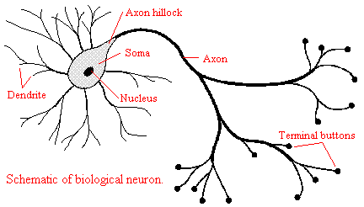
Perceptron [Rosenblatt ‘58]
(very) Loose motivation: Neuron
Inputs are feature values
Each feature has a weight w_{i}
Activation is the sum:
f(x) = Σ_{i} w_{i} x_{i} = w⋅ x
If the f(x) is:
Positive: Predict +1
Negative: Predict -1
w₁
w₂
w₃
w₄
x₁
x₂
x₃
x₄
∑
≥ 0?
w⋅x=0
nigeria
x⁽¹⁾
x⁽²⁾
Spam=1
w
Ham=-1
viagra

Slide 15
Perceptron: Estimating w
Note that the Perceptron is a conservative algorithm: it ignores samples that it classifies correctly.
Perceptron: y’ = sign(w⋅ x)
How to find parameters w?
Start with w₀ = 0
Pick training examples x^{(t)} one by one (from disk)
Predict class of x^{(t)} using current weights
y’ = sign(w^{(t)}⋅ x^{(t)})
If y’ is correct (i.e., y_{t} = y’)
No change: w^{(t+1)} = w^{(t)}
If y’ is wrong: adjust w^{(t)}
w^{(t+1)} = w^{(t)} + η ⋅ y ^{(t)} ⋅ x^{(t)}
η is the learning rate parameter
x^{(t)} is the t-th training example
y^{(t)} is true t-th class label ({+1, -1})
η⋅y^{(t)}⋅x^{(t)}
w^{(t)}
w^{(t+1)}
x^{(t)}, y^{(t)}=1

Slide 16
Perceptron Convergence
Perceptron Convergence Theorem:
If there exist a set of weights that are consistent (i.e., the data is linearly separable) the Perceptron learning algorithm will converge
How long would it take to converge?
Perceptron Cycling Theorem:
If the training data is not linearly separable the Perceptron learning algorithm will eventually repeat the same set of weights and therefore enter an infinite loop
How to provide robustness, more expressivity?

Slide 17
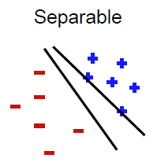
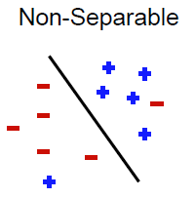
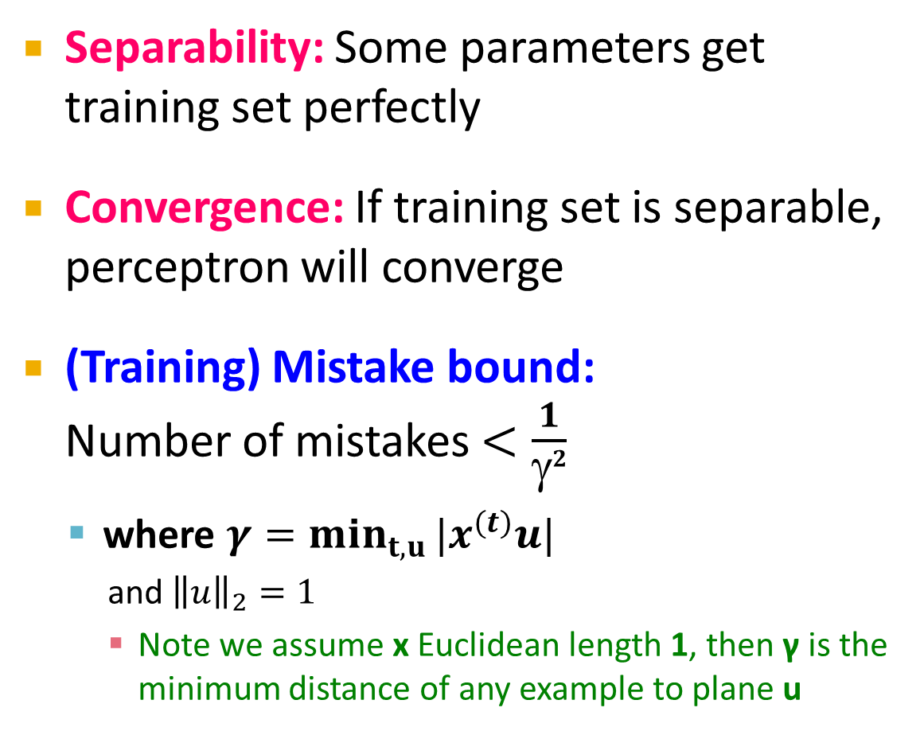
Properties of Perceptron
Separability: Some parameters get training set perfectly
Convergence: If training set is separable, perceptron will converge
(Training) Mistake bound: Number of mistakes $<\frac{1}{γ2}$
where $γ=\min_{t,u}{|x^{(t)}u|}$
and ${\left\|u\right\|}_{2}=1$
Note we assume x Euclidean length 1, then γ is the minimum distance of any example to plane u
Notes:
Gamma = margin
if we scale examples to have Euclidean length 1, then γ is the minimum distance of
any example to the plane

Slide 18
Updating the Learning Rate
Perceptron will oscillate and won’t converge
When to stop learning?
(1) Slowly decrease the learning rate η
A classic way is to: η = c₁/(t + c₂)
But, we also need to determine constants c₁ and c₂
(2) Stop when the training error stops chaining
(3) Have a small test dataset and stop when the test set error stops decreasing
(4) Stop when we reached some maximum number of passes over the data

Slide 19
Multiclass Perceptron
What if more than 2 classes?
Weight vector w_{c} for each class c
Train one class vs. the rest:
Example: 3-way classification y = {A, B, C}
Train 3 classifiers: w_{A}: A vs. B,C; w_{B}: B vs. A,C; w_{C}: C vs. A,B
Calculate activation for each class
f(x,c) = Σ_{i} w_{c,i} x_{i} = w_{c}⋅ x
Highest activation wins
c = arg max_{c} f(x,c)
w_{C}⋅x biggest
w_{C}
w_{B}
w_{B}⋅x biggest
w_{A}
w_{A}⋅x biggest

Slide 20
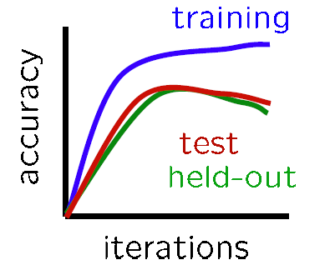
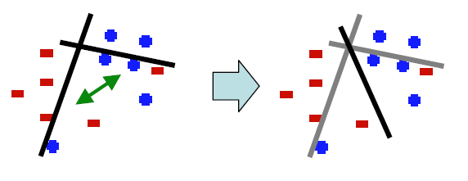
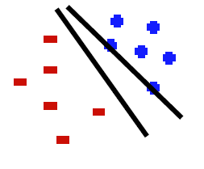
Issues with Perceptrons
Overfitting:
Regularization: If the data is not separable weights dance around
Mediocre generalization:
Finds a “barely” separating solution

Slide 21

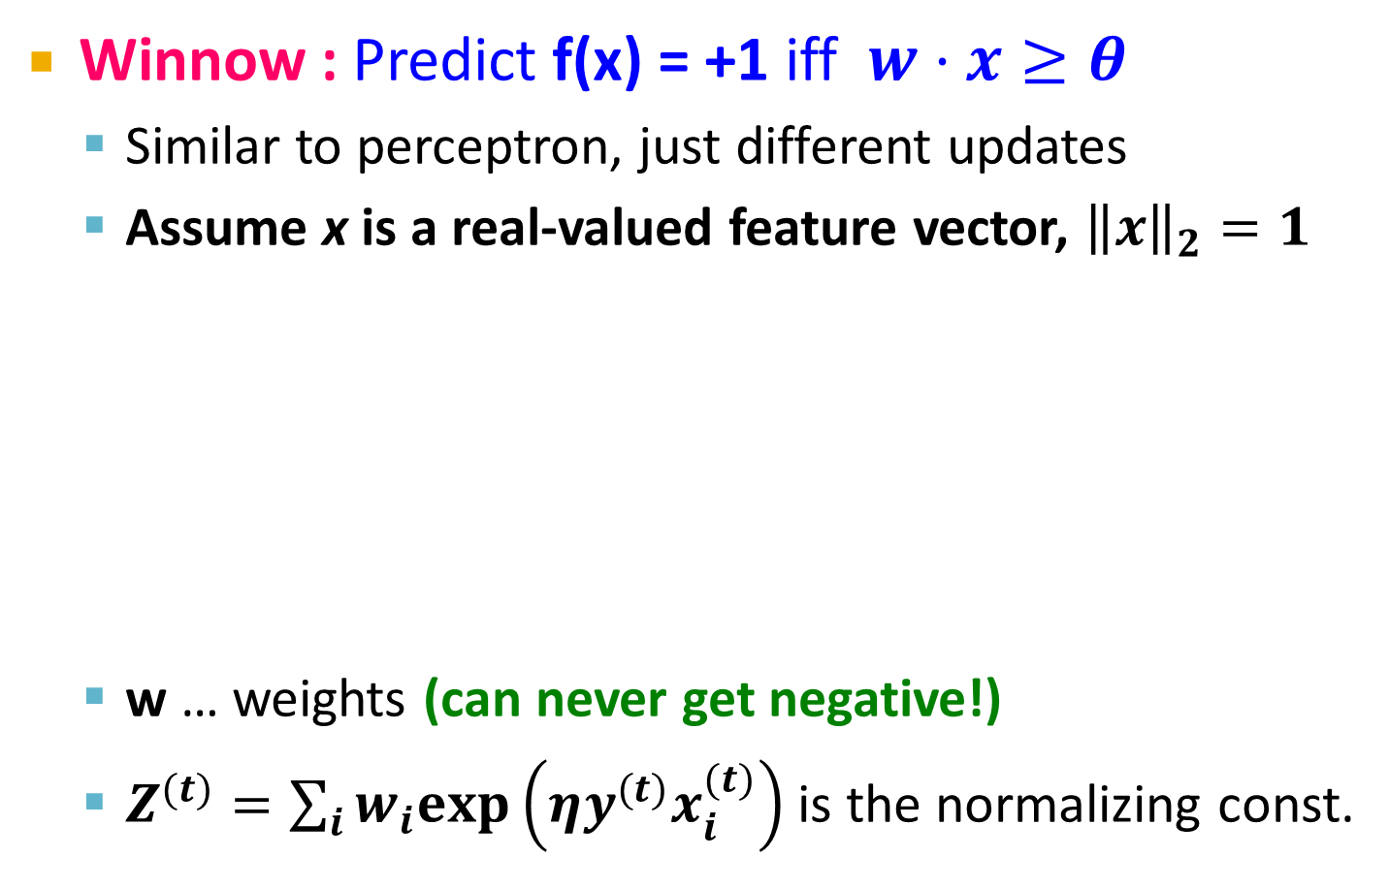
Improvement: Winnow Algorithm
Winnow : Predict f(x) = +1 iff $w⋅x≥θ$
Similar to perceptron, just different updates
Assume x is a real-valued feature vector, ${\left\|x\right\|}_{2}=1$
w … weights (can never get negative!)
$Z^{(t)}=\sum_{i}{w_{i}exp\left(ηy^{(t)}x_{i}^{(t)}\right)}$ is the normalizing const.
Initialize: $θ=\frac{d}{2}, w=\left[\frac{1}{d},…,\frac{1}{d}\right]$
For every training example $x^{(t)}$
Compute $y^{′} = f(x^{(t)})$
If no mistake ($y^{(t)}=y′$): do nothing
If mistake then: $w_{i}←w_{i}\frac{exp\left(ηy^{(t)}x_{i}^{(t)}\right)}{Z^{(t)}}$

Slide 22
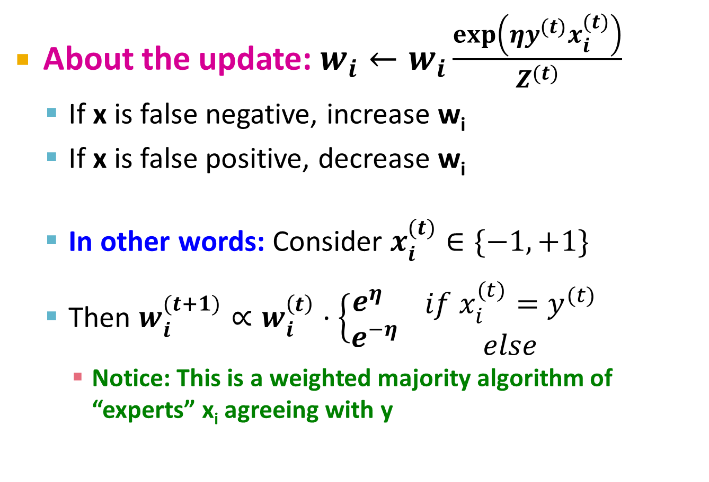
Improvement: Winnow Algorithm
About the update: $w_{i}←w_{i}\frac{exp\left(ηy^{(t)}x_{i}^{(t)}\right)}{Z^{(t)}}$
If x is false negative, increase w_{i}
If x is false positive, decrease w_{i}
In other words: Consider $x_{i}^{(t)}∈\{−1,+1\}$
Then $w_{i}^{(t+1)}∝w_{i}^{\left(t\right)}⋅\left\{\begin{matrix}e^{η} \\ e^{−η}\end{matrix}\right. \begin{matrix}if x_{i}^{(t)}=y^{(t)} \\ else\end{matrix}$
Notice: This is a weighted majority algorithm of “experts” x_{i} agreeing with y
(promote)
(demote)

Slide 23
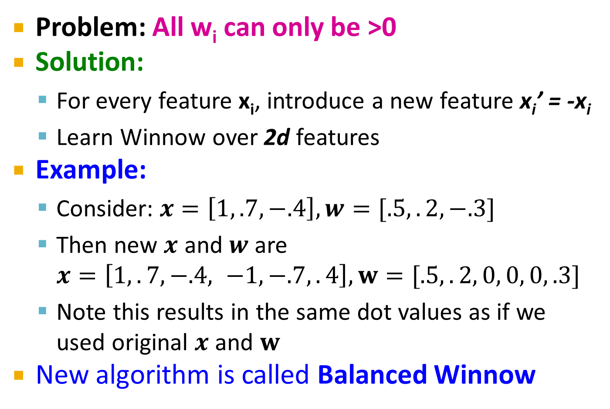
Extensions: Winnow
Problem: All w_{i} can only be >0
Solution:
For every feature x_{i}, introduce a new feature x_{i}’ = -x_{i}
Learn Winnow over 2d features
Example:
Consider: $x=\left[1, .7, −.4\right], w=[.5,.2,−.3]$
Then new $x$ and $w$ are $x=\left[1,.7,−.4, −1, −.7,.4\right], w=[.5,.2, 0, 0, 0, .3]$
Note this results in the same dot values as if we used original $x$ and $w$
New algorithm is called Balanced Winnow

Slide 24
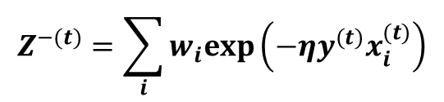
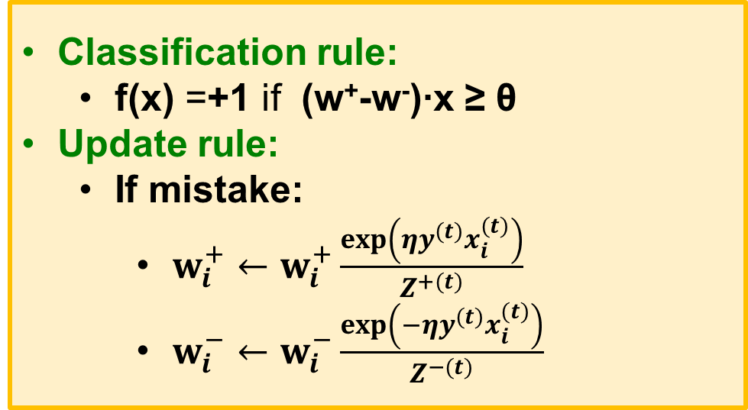
Extensions: Balanced Winnow
In practice we implement Balanced Winnow:
2 weight vectors w⁺, w⁻; effective weight is the difference
Classification rule:
f(x) =+1 if (w⁺-w⁻)∙x ≥ θ
Update rule:
If mistake:
$w_{i}^{+}←w_{i}^{+}\frac{exp\left(ηy^{(t)}x_{i}^{(t)}\right)}{Z^{+(t)}}$
$w_{i}^{−}←w_{i}^{−}\frac{exp\left(−ηy^{(t)}x_{i}^{(t)}\right)}{Z^{−(t)}}$
$$Z^{−(t)}=\sum_{i}{w_{i}exp\left(−ηy^{(t)}x_{i}^{(t)}\right)}$$

Slide 25
Extensions: Thick Separator
Thick Separator (aka Perceptron with Margin) (Applies both to Perceptron and Winnow)
Set margin parameter γ
Update if y=+1 but w ⋅ x < θ + γ
or if y=-1 but w ⋅ x > θ - γ
-
-
-
-
-
-
-
-
-
-
-
-
w ⋅ x = θ+γ
-
-
-
w ⋅ x = θ
w ⋅ x = 0
w
w ⋅ x = θ-γ
Note: γ is a functional margin. Its effect could disappear as w grows.
Nevertheless, this has been shown to be a very effective algorithmic addition.

Slide 26
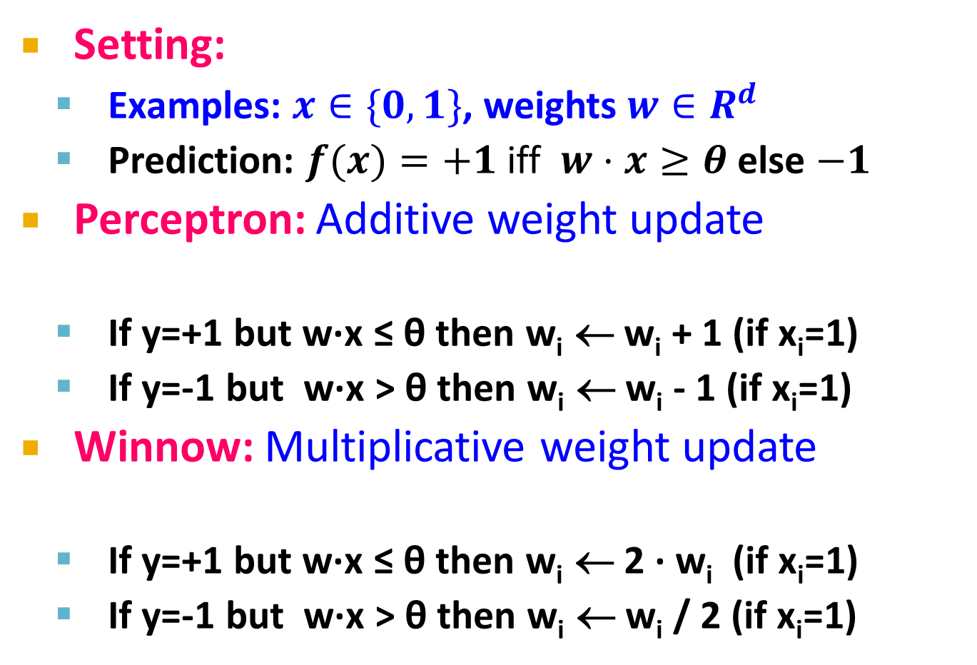
Summary of Algorithms
Setting:
Examples: $x∈\{0,1\}$, weights $w∈R^{d}$
Prediction: $f(x)=+1$ iff $w⋅x≥θ$ else $−1$
Perceptron: Additive weight update
If y=+1 but w∙x ≤ θ then w_{i} ← w_{i} + 1 (if x_{i}=1)
If y=-1 but w∙x > θ then w_{i} ← w_{i} - 1 (if x_{i}=1)
Winnow: Multiplicative weight update
If y=+1 but w∙x ≤ θ then w_{i} ← 2 ∙ w_{i} (if x_{i}=1)
If y=-1 but w∙x > θ then w_{i} ← w_{i} / 2 (if x_{i}=1)
w ← w + η y x
(promote)
(demote)
w ← w exp{η y x}
(promote)
(demote)

Slide 27
Perceptron vs. Winnow
How to compare learning algorithms?
Considerations:
Number of features d is very large
The instance space is sparse
Only few features per training example are non-zero
The model is sparse
Decisions depend on a small subset of features
In the “true” model on a few w_{i} are non-zero
Want to learn from a number of examples that is small relative to the dimensionality d

Slide 28
Perceptron vs. Winnow
Perceptron
Online: Can adjust to changing target, over time
Advantages
Simple
Guaranteed to learn a linearly separable problem
Advantage with few relevant features per training example
Limitations
Only linear separations
Only converges for linearly separable data
Not really “efficient with many features”
Winnow
Online: Can adjust to changing target, over time
Advantages
Simple
Guaranteed to learn a linearly separable problem
Suitable for problems with many irrelevant attributes
Limitations
Only linear separations
Only converges for linearly separable data
Not really “efficient with many features”

Slide 29
Online Learning
New setting: Online Learning
Allows for modeling problems where we have a continuous stream of data
We want an algorithm to learn from it and slowly adapt to the changes in data
Idea: Do slow updates to the model
Both our methods Perceptron and Winnow make updates if they misclassify an example
So: First train the classifier on training data. Then for every example from the stream, if we misclassify, update the model (using small learning rate)

Slide 30
Example: Shipping Service
Protocol:
User comes and tell us origin and destination
We offer to ship the package for some money ($10 - $50)
Based on the price we offer, sometimes the user uses our service (y = 1), sometimes they don't (y = -1)
Task: Build an algorithm to optimize what price we offer to the users
Features x capture:
Information about user
Origin and destination
Problem: Will user accept the price?

Slide 31
Example: Shipping Service
Model whether user will accept our price: y = f(x; w)
Accept: y =1, Not accept: y=-1
Build this model with say Perceptron or Winnow
The website that runs continuously
Online learning algorithm would do something like
User comes
She is represented as an (x,y) pair where
x: Feature vector including price we offer, origin, destination
y: If they chose to use our service or not
The algorithm updates w using just the (x,y) pair
Basically, we update the w parameters every time we get some new data

Slide 32
Example: Shipping Service
We discard this idea of a data “set”
Instead we have a continuous stream of data
Further comments:
For a major website where you have a massive stream of data then this kind of algorithm is pretty reasonable
Don’t need to deal with all the training data
If you had a small number of users you could save their data and then run a normal algorithm on the full dataset
Doing multiple passes over the data

Slide 33
Online Algorithms
An online algorithm can adapt to changing user preferences
For example, over time users may become more price sensitive
The algorithm adapts and learns this
So the system is dynamic

